Slide 1
Android
By: Justin, Christian, Tony, & Fatima

Slide 2

Demo of App

Slide 3
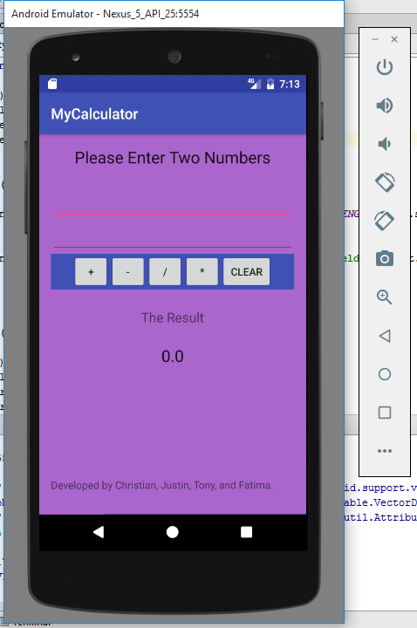
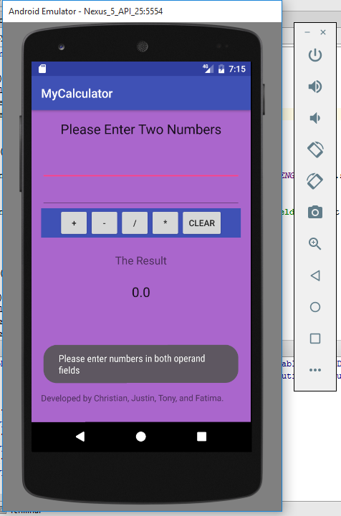
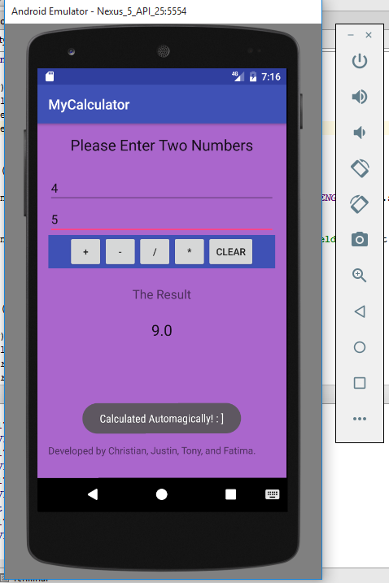
Run Through Program

Slide 4
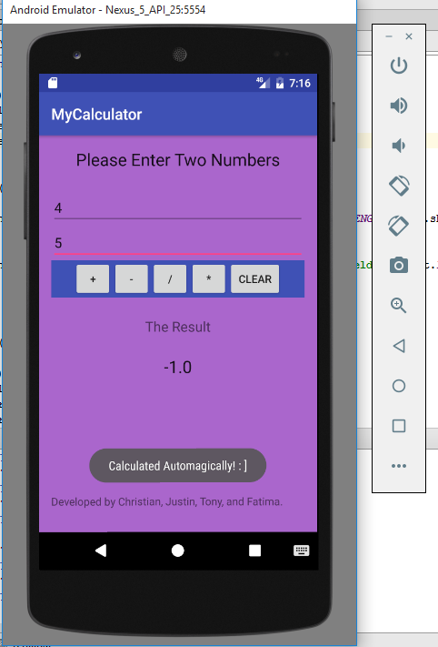
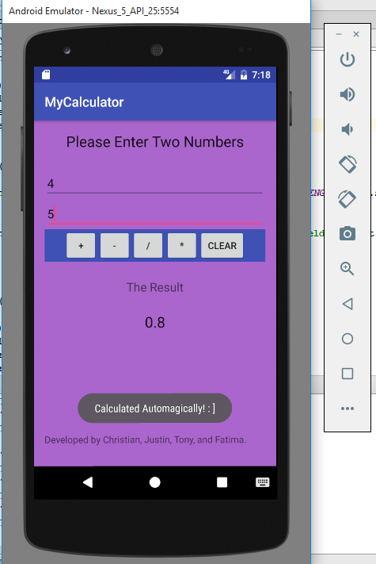
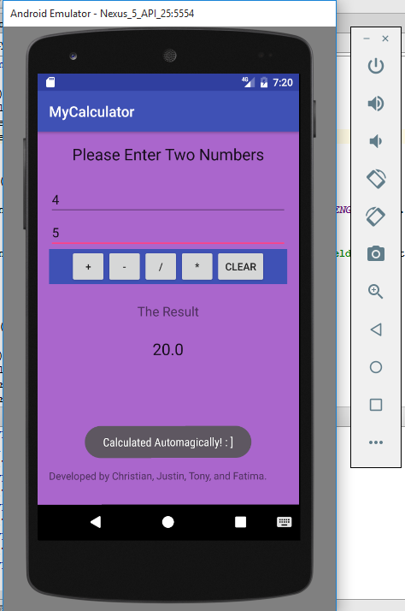
Run Through Program

Slide 5
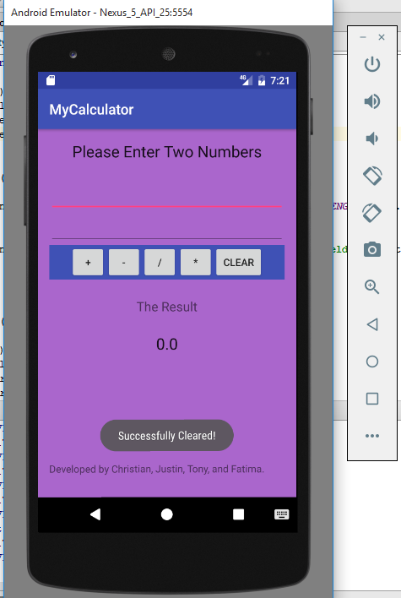
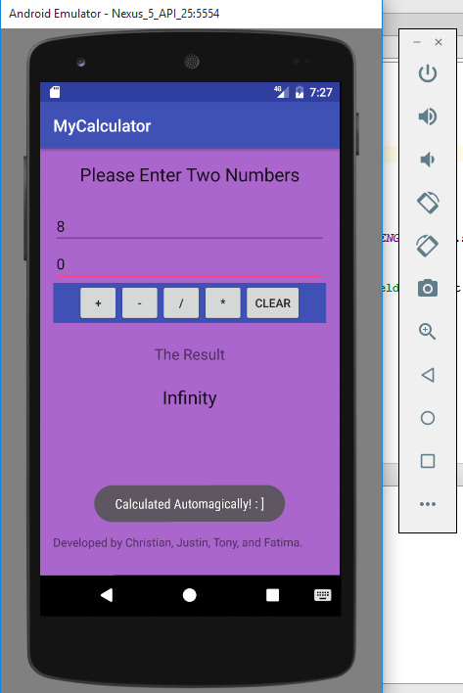
Run Through Program

Slide 6
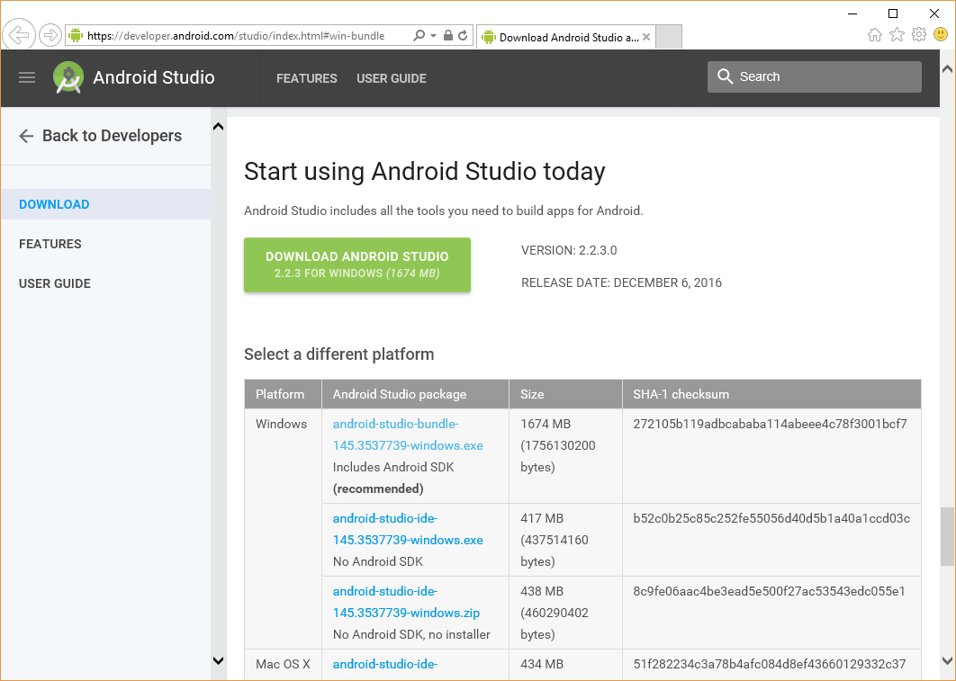
Getting Started with Android Studio
Download official IDE
You will need the JDK first
Memory allocation - 8 GB
Check for updates
Notes:
Tutorial on Android Authority website
Download official Android IDE (by Google)
You will need Java Development Kit from Oracle first (right version for your copy of Windows 32/64)
Memory allocation for emulator
Android Studio, Java, and the emulator running together
3 GB required, 8 recommended. Problems reported even with 8. But RAM is cheap and easy to install.

Slide 7
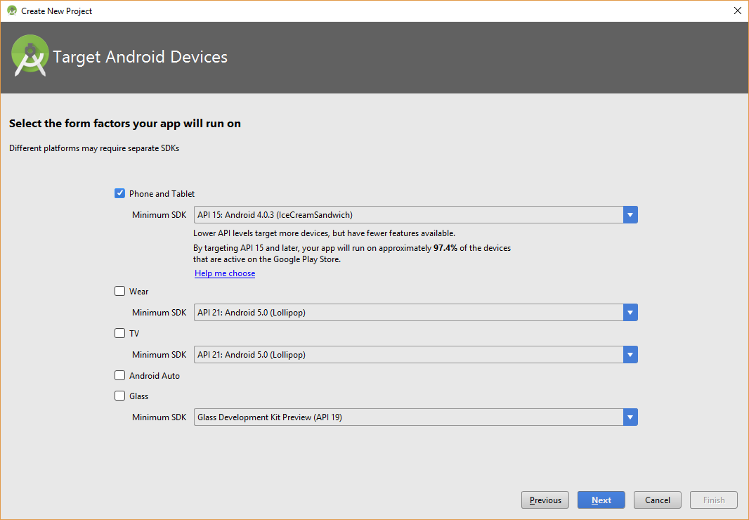
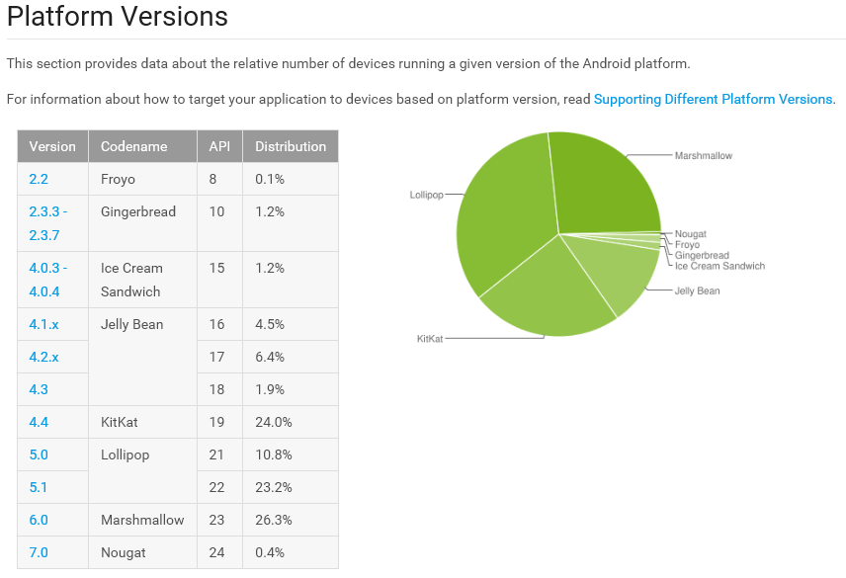
Android Packages and Backwards Compatibility - “Android Dashboards”
Notes:
SDK takes a bit to start
Make sure to check for updates
Android packages - backwards compatibility - you have to set Minimum SDK
https://developer.android.com/about/dashboards/index.html
AVD Manager - create a virtual device
Use Host GPU
There are other options, like http://nbandroid.org/. It's a bridge between NetBeans and the Android SDK - creates a project type for Android

Slide 8
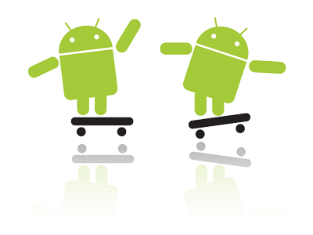
Why is Android Useful? - Consumer Perspective
It’s affordable to the average user
Allows for alternative app stores and side loading (geek friendly!)

Slide 9

Why is Android Useful? - Consumer Perspective
To make BANK, bro!

Slide 10
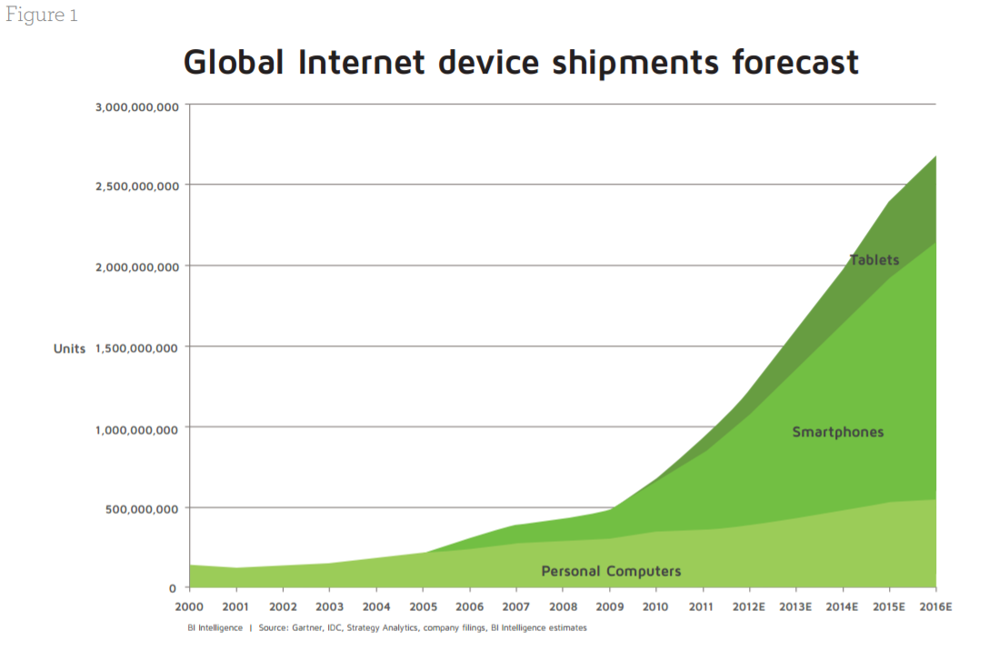
Why Should I Care?
Consumers are transitioning to a Mobile Economy
More businesses are transitioning to mobile tools

Slide 11
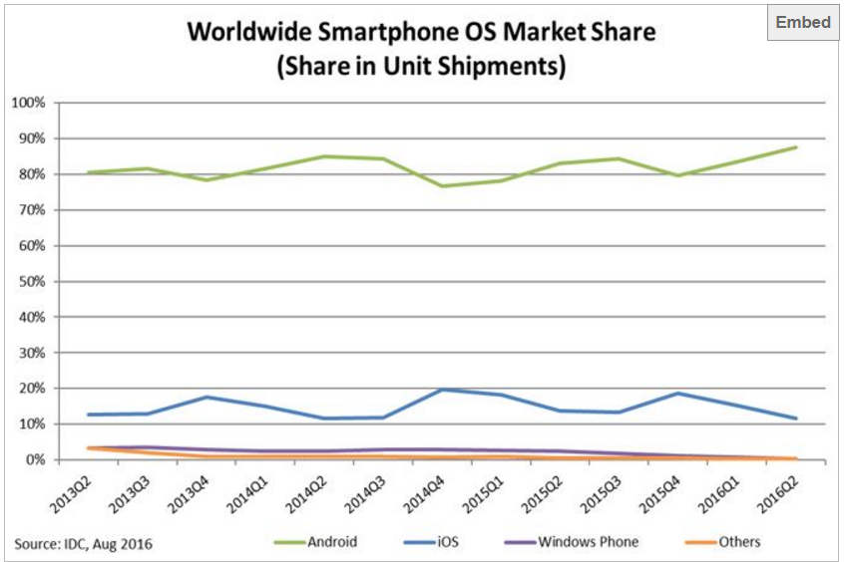
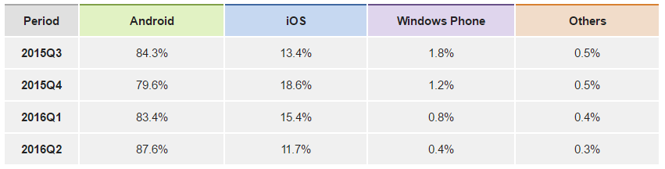
Why Should I Care?
It’s dominating the Smartphone market!

Slide 12

Trends of Mobile Apps
- Cloud Technology
- Security in Apps
- Location Based and Beacon
- Wearable Tech
- Mobile Pay

Slide 13

Revenue
-Returning to China
China has 601 million smartphones
App Market
$$$$

Slide 14
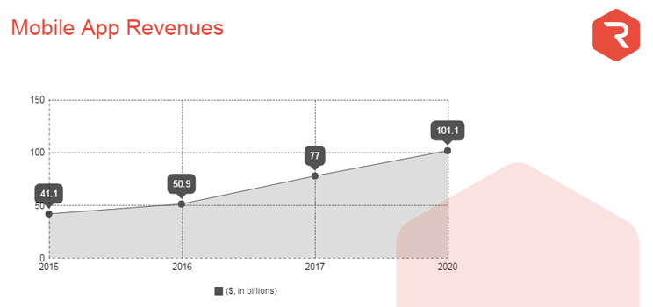

Slide 15
Popularity

Slide 16
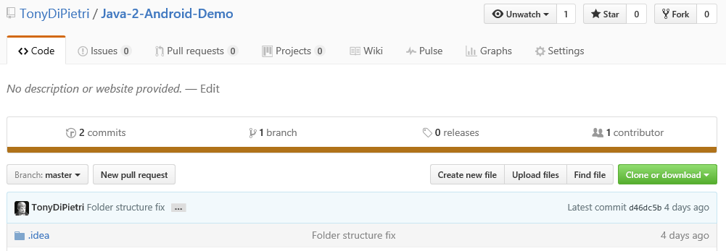
Download Our Code!
https://github.com/TonyDiPietri/Java-2-Android-Demo

Slide 17
Android Development Tips
Every application must have an AndroidManifest.xml file.
Names the Java package
Declares permissions
Protected API functions
Sending to other apps
Permissions other apps need
Declares minimum API level needed on device
Developer.android.com “App Manifest” page w/ clickable code

Slide 18
Android App Components
Android apps are written in Java and user interfaces are called activities. Activities are subclasses of the Activity class.
MainActivity.java - entry point
Services run in the background and have no user interface (play music, get data). Subclass of Service.
Broadcast receivers - can receive notifications (alarms) even if the app is not currently running. Can also create status bar notifications. Subclass of BroadcastReceiver.
ContentProvider - for sharing data between apps

Slide 19
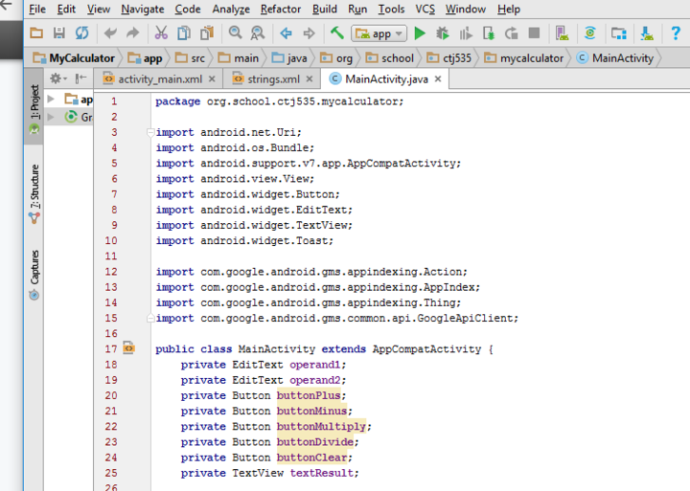
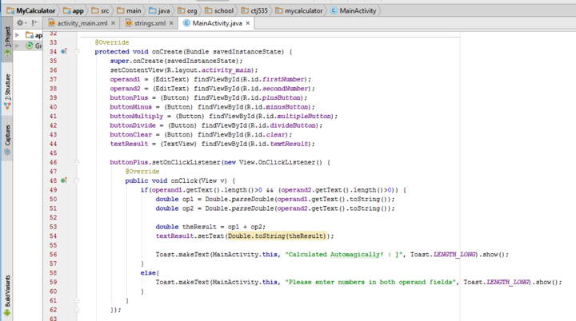
Run Through Code

Slide 20
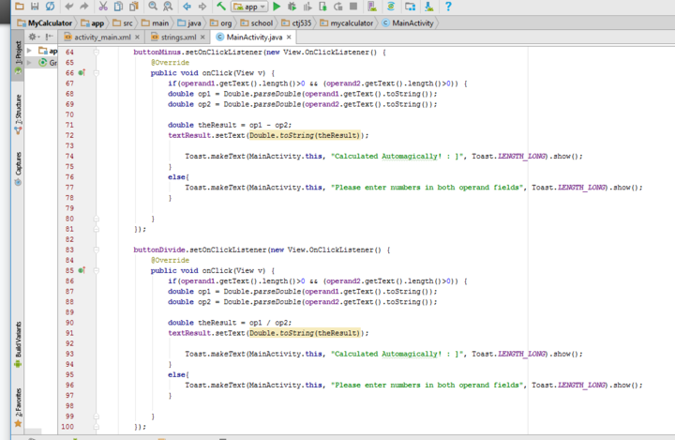
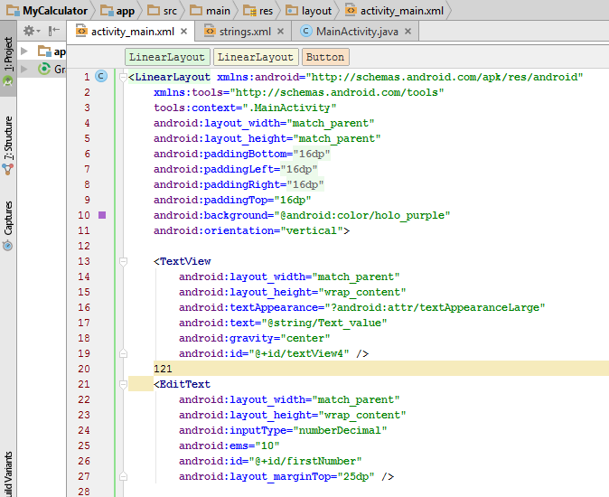
Run Through Code

Slide 21
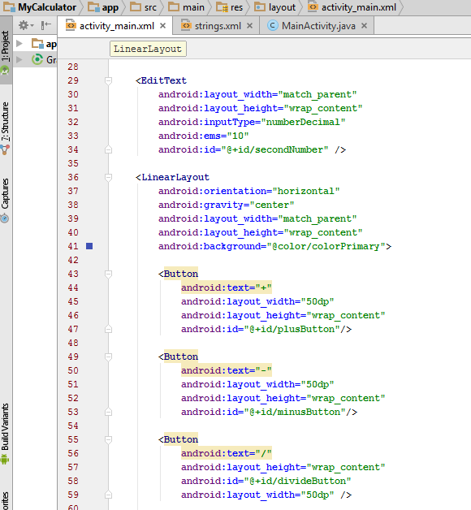
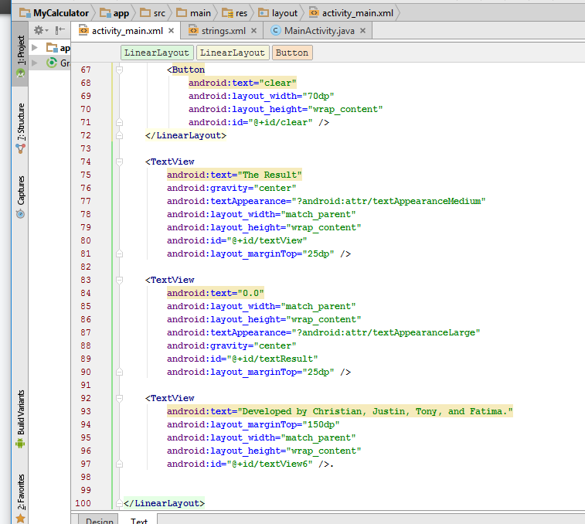
Run Through Code

Slide 22
References
http://digitalclaritygroup.com/wordpress/wp-content/uploads/2012/12/DCG-Insight-Understanding-the-Mobile-Shift-Nov-2012.pdf
http://www.digitaltrends.com/mobile/best-smartphone-os/
https://www.udemy.com/s2k-android-beginners/learn/v4/overview
https://www.idc.com/prodserv/smartphone-os-market-share.jsp
http://r-stylelab.com/company/blog/mobile-technologies/mobile-app-development-trends-for-2017-beyond
https://www.infoq.com/articles/latest-mobile-app-development-trends

Slide 23

Bonus Information!

Slide 24
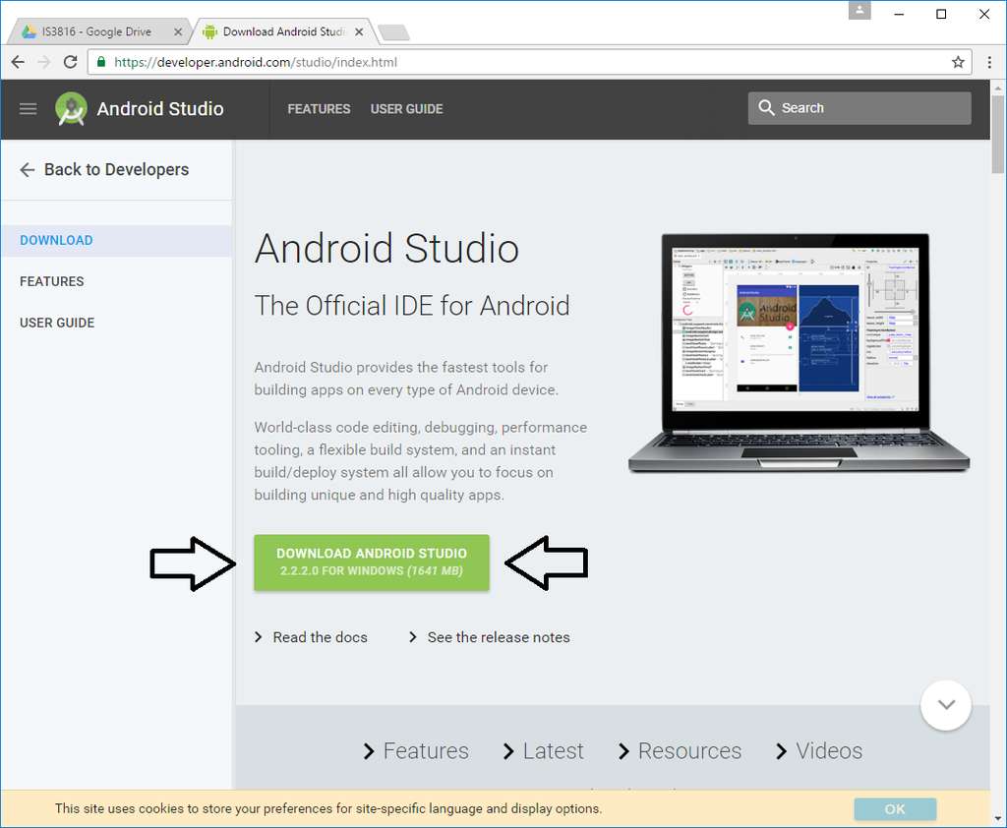
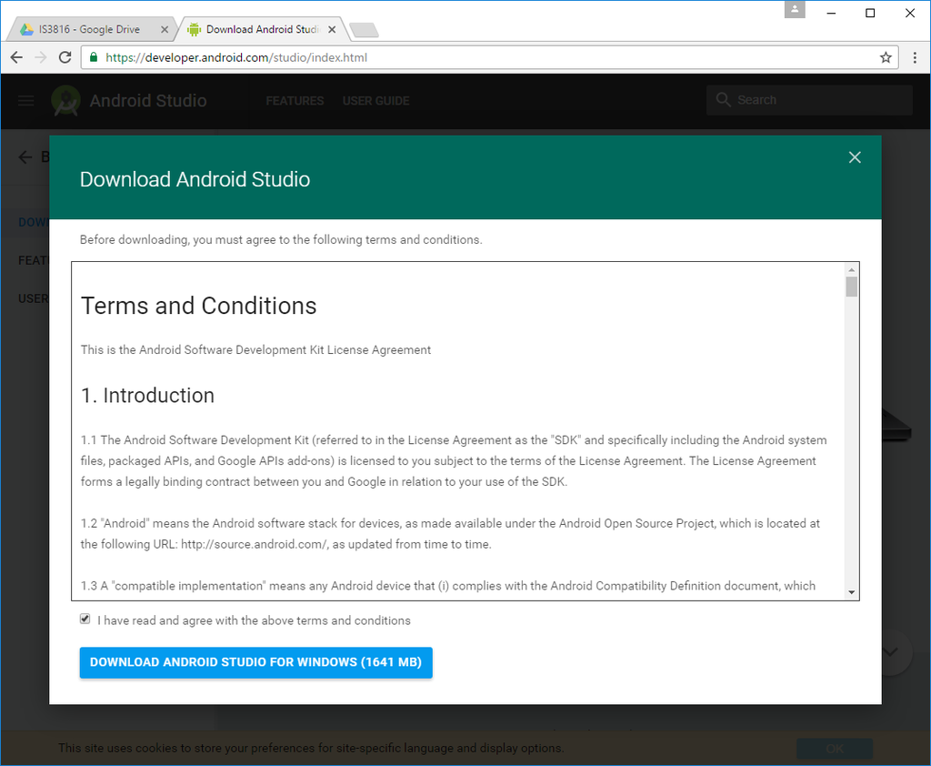
How to Setup Android Studio

Slide 25
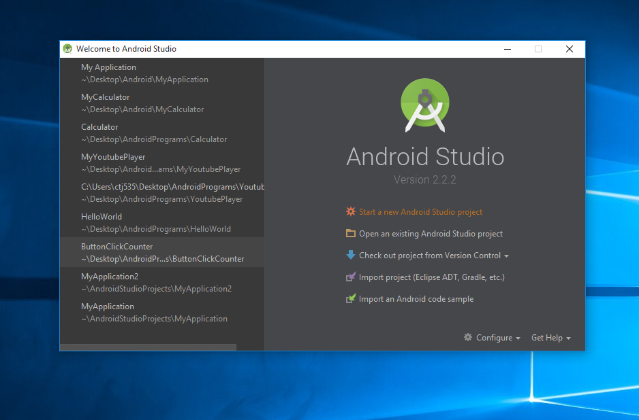
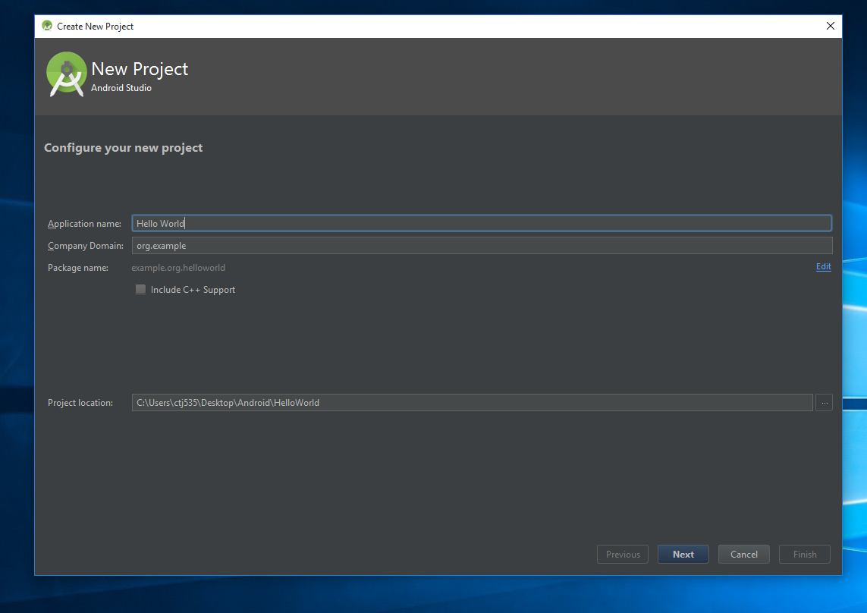
How to Setup a Project in Android Studio

Slide 26
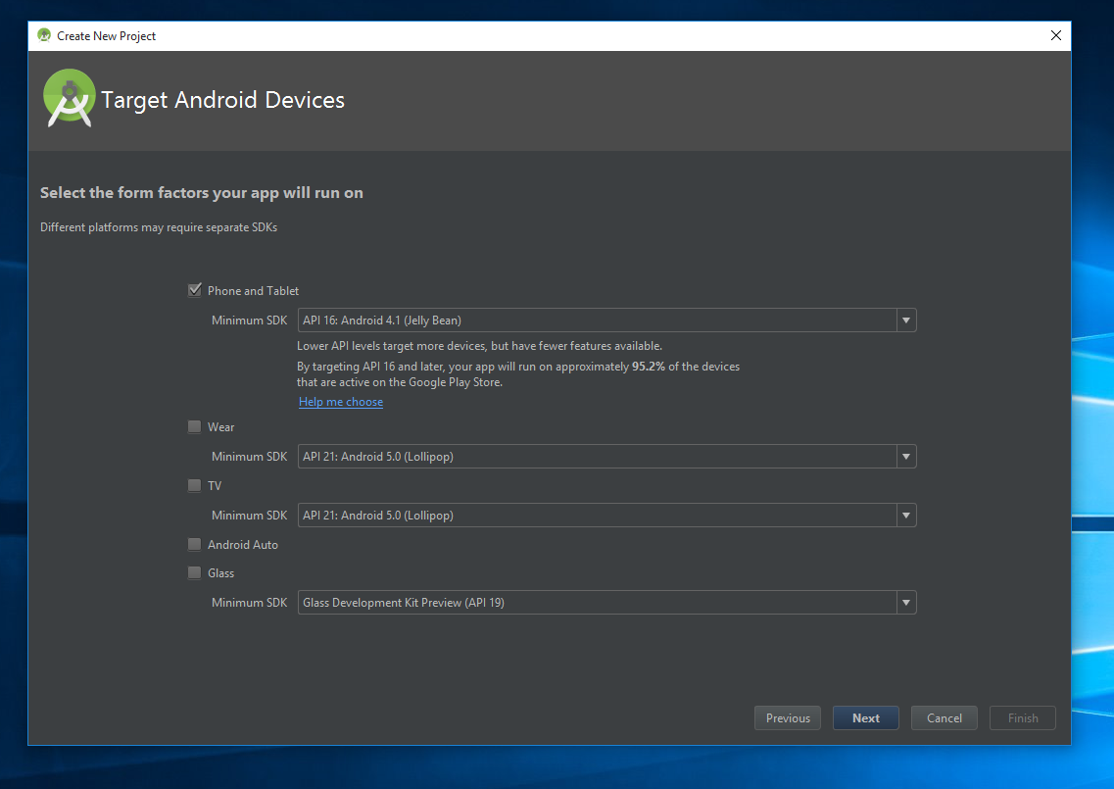
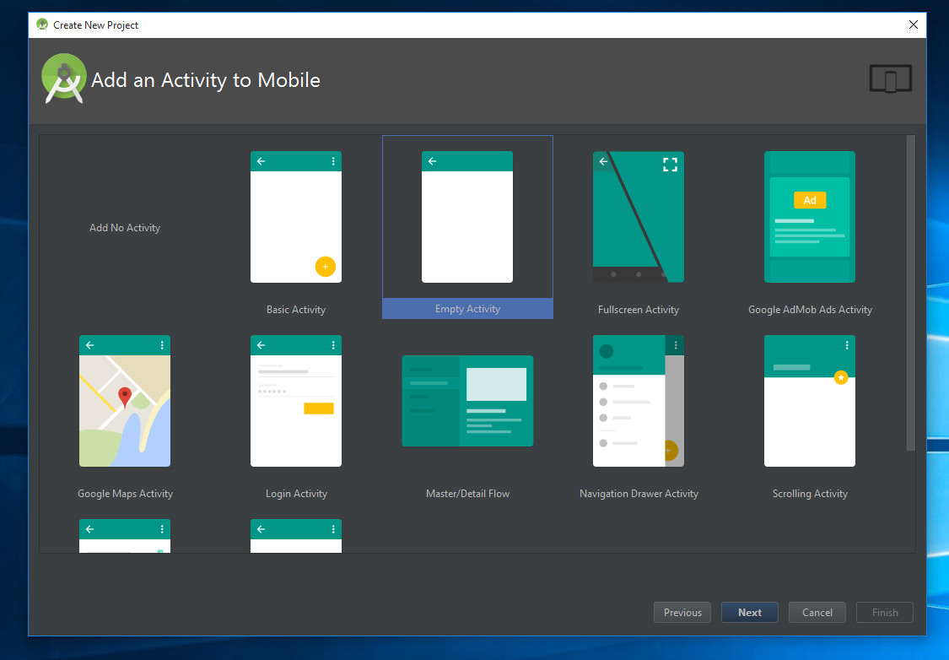
How to Setup a Project in Android Studio

Slide 27
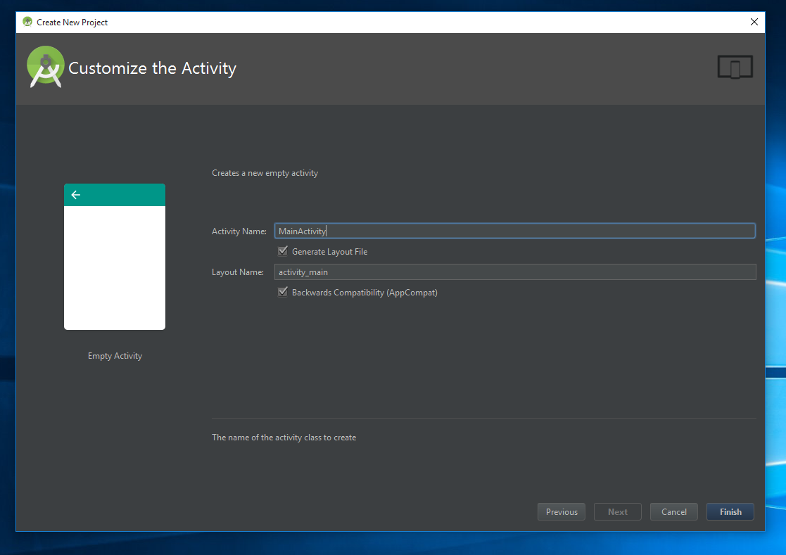
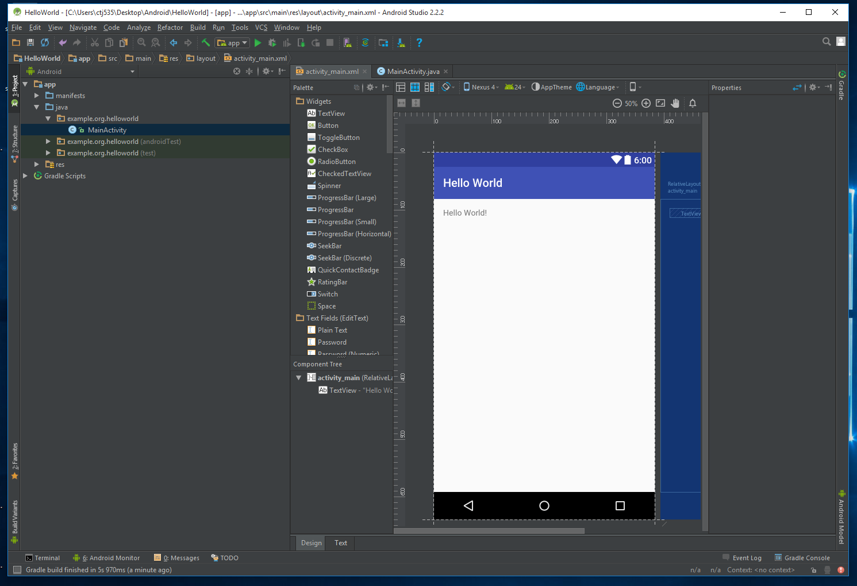
How to Setup a Project in Android Studio

Slide 28
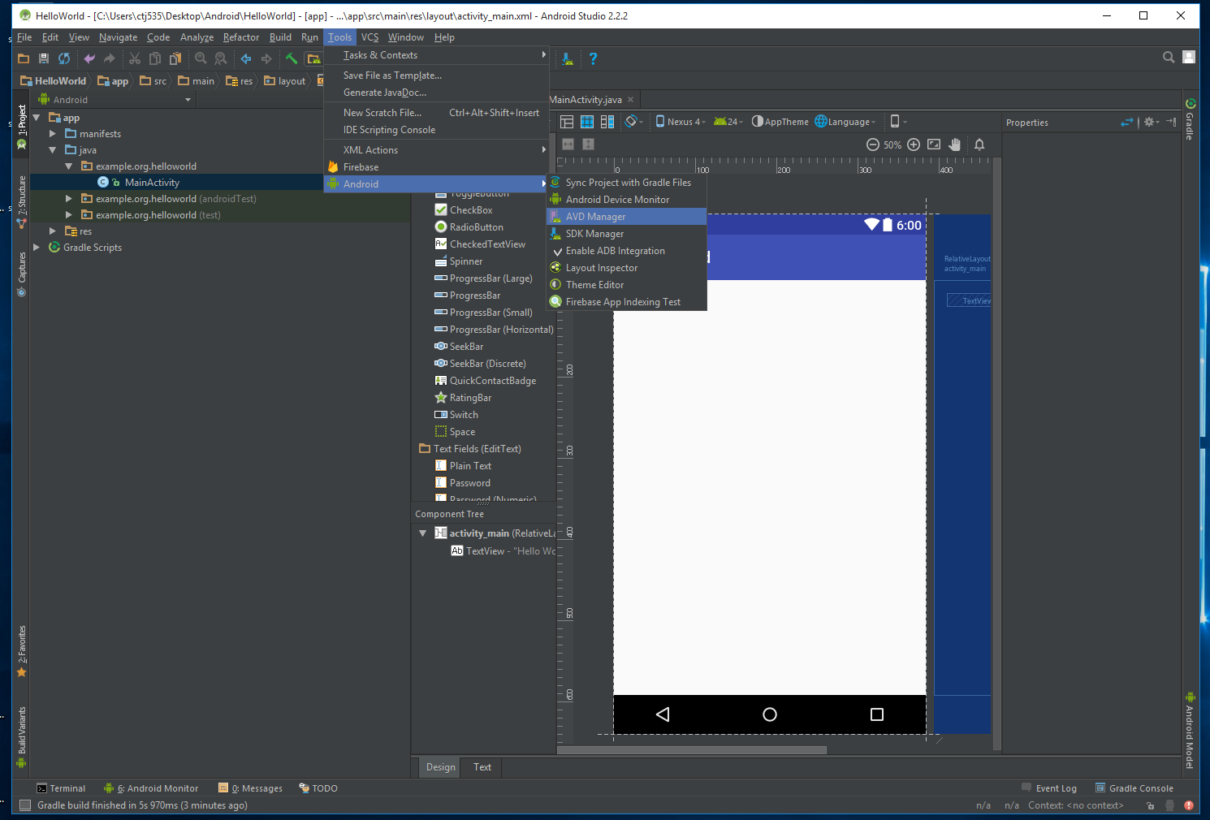
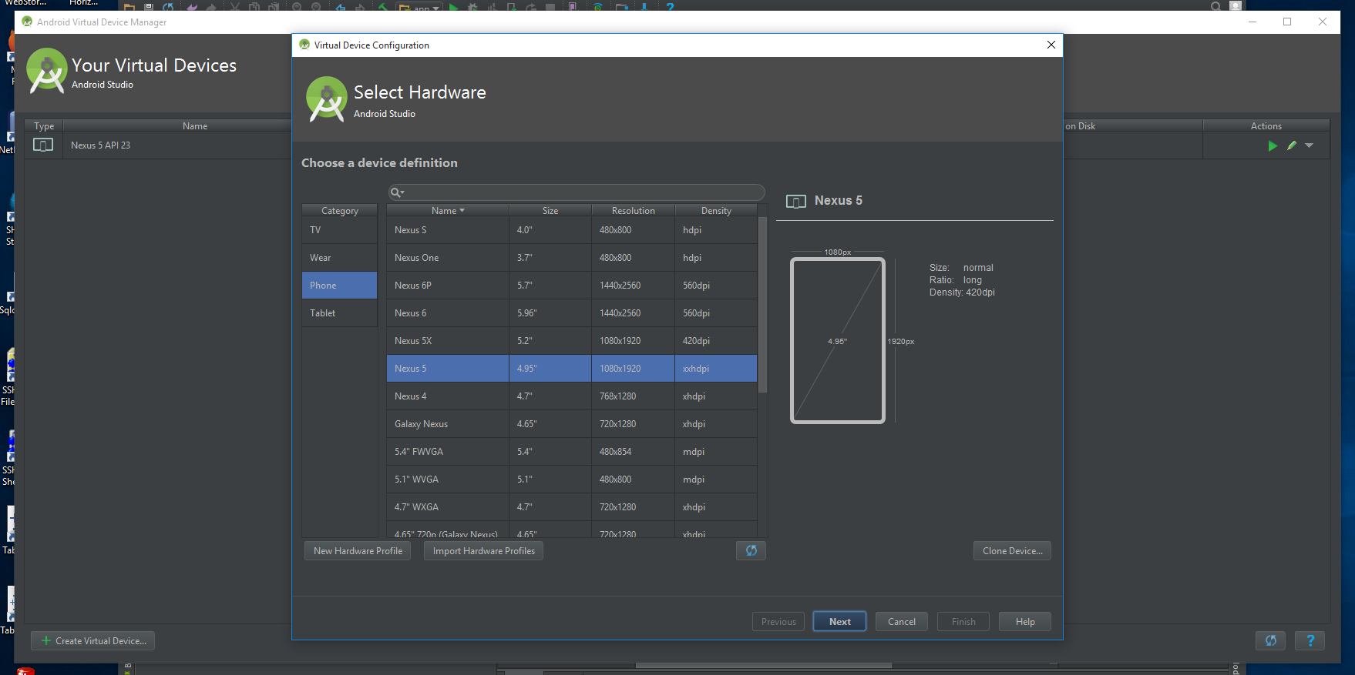
How to Setup a Project in Android Studio

Slide 29
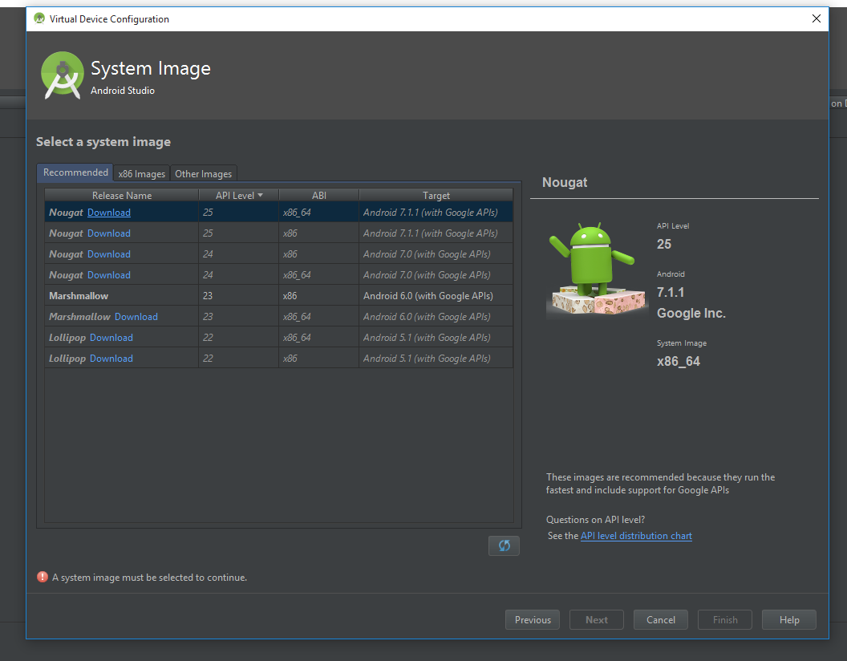
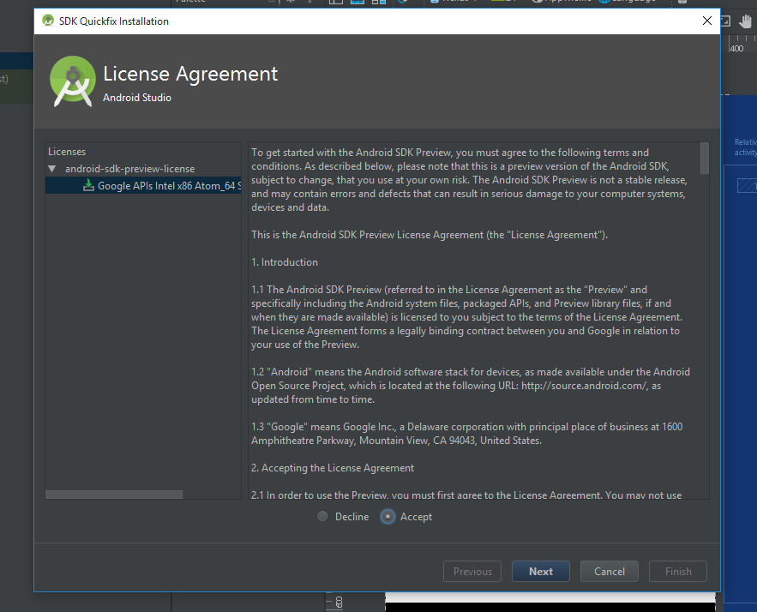
How to Setup a Project in Android Studio

Slide 30
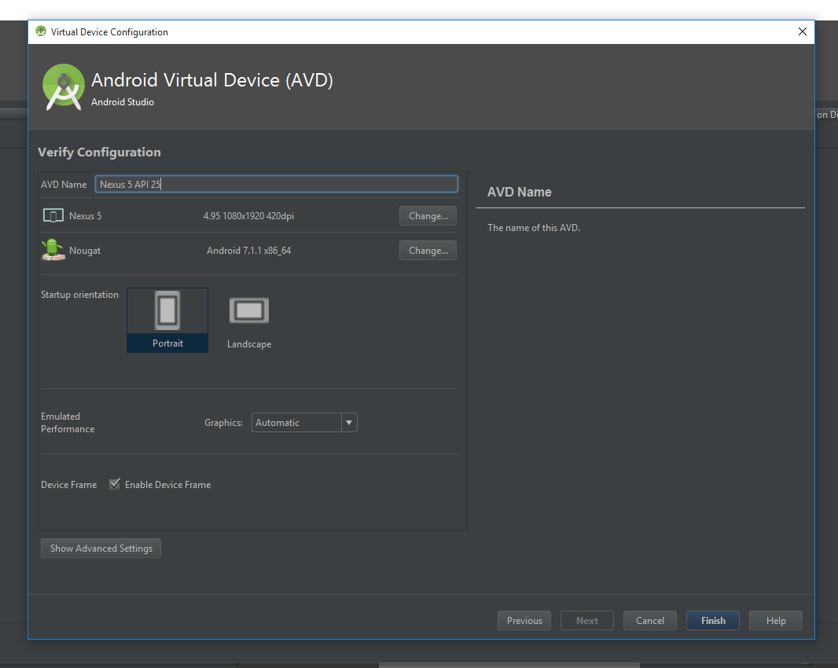
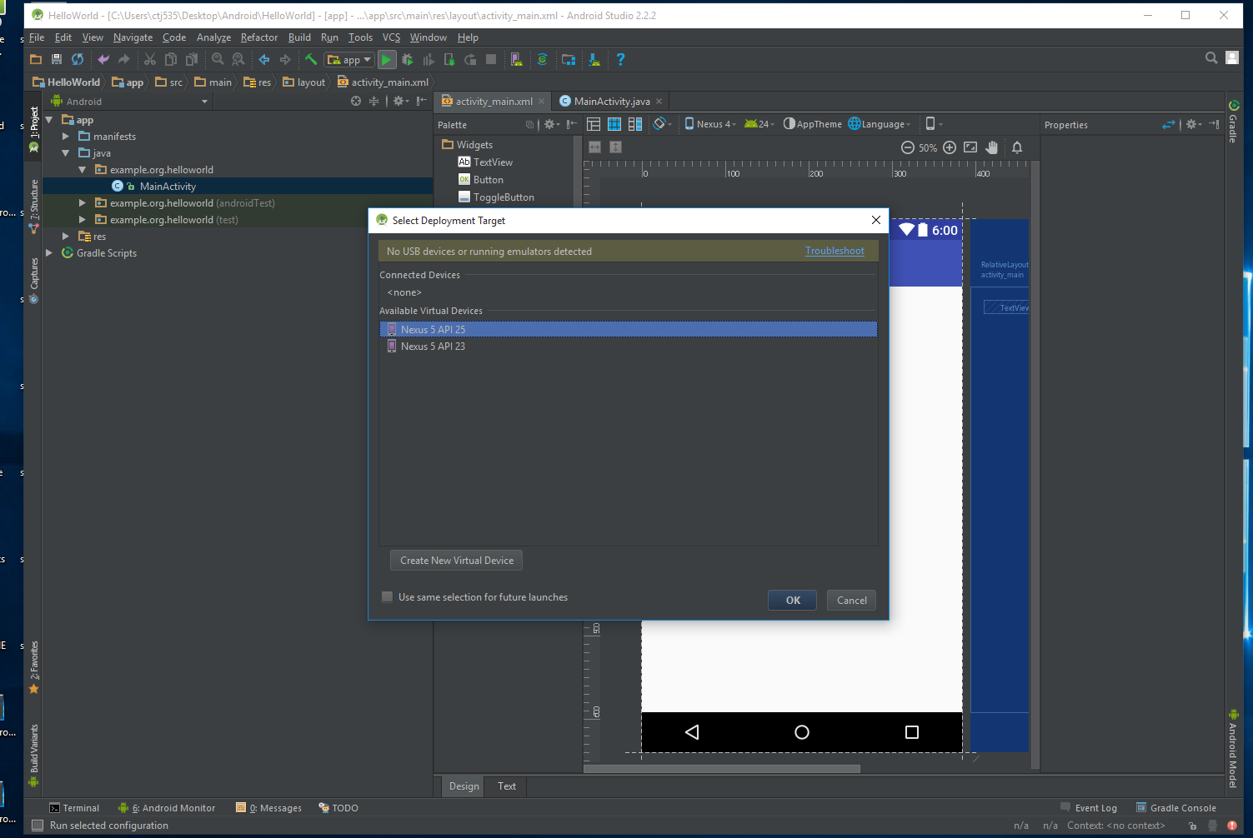
How to Setup a Project in Android Studio

Slide 31
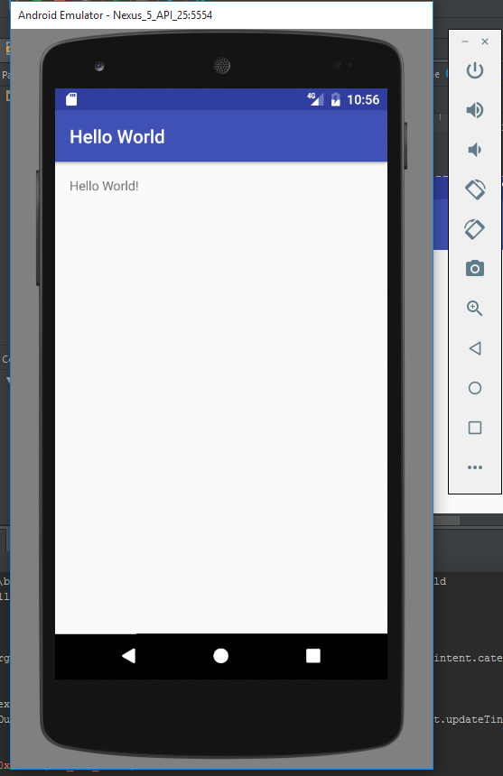
How to Setup a Project in Android Studio

Slide 32

Questions?

Slide 33

Thanks for Watching!

